Slide 1

Can Pandemic Spreads be predicted?
Muthukumar Kadhirvel

Slide 2
Contents
What is a pandemic and how it spreads?
Why Are Pandemic Spreads Exponential?
R – Reproduction number
Pandemic Spread Variables
Pandemic Spread Models
COVID 19 Spread Prediction Models
COVID Calculator
Conclusion
References

Slide 3
What is a pandemic and how it spreads?
Outbreak – Sudden rise in the number of cases of a disease and can be local to an area or affect multiple countries. Can last for a few days, weeks or years.
Epidemic – When an infectious disease spreads rapidly to many people
Pandemic – Global disease outbreak
Affects wider geographical area, often worldwide.
Infects more people than epidemic
Often caused by new virus that humans have no immunity against
Causes more deaths than epidemic
Single infected person can board a plane and spread a virus among continents.
Size of population of opportunity
Number of days contagious
Number of people with whom an infectious person comes in contact
Probability of contracting the virus from contact with an infected person

Slide 4
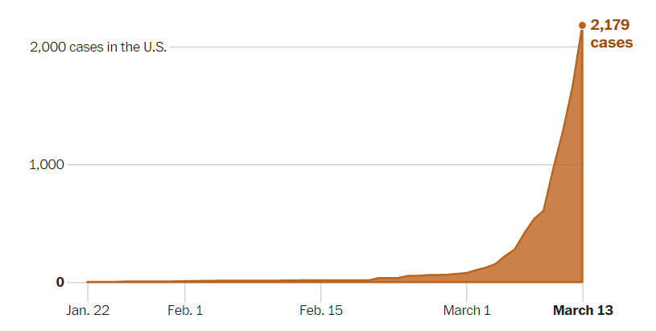
Why Are Pandemic Spreads Exponential?
In March 2020 alone, COVID cases in USA increased from a few dozen to 200,000 cases.
If money doubles every 3 days and if you invest $1 today, then how long it takes to become a millionaire?
In 60 days, you would have $1,048,576. In another 30 days you would be a billionaire.
This is how the pandemic spreads as one person can infect another, and that person can infect other and hence the pandemic spread is not linear but always exponential.
Many people underestimate how fast the value increases which is called Exponential Growth Bias.

Slide 5
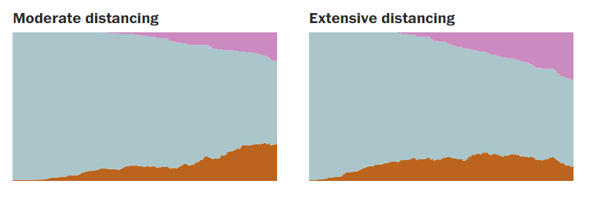
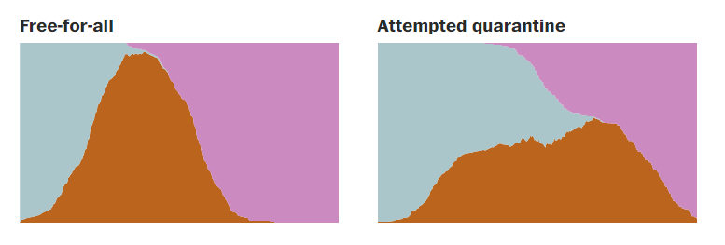
Why Are Pandemic Spreads Exponential?
Recovered
Healthy
Sick

Slide 6
R – Reproduction Number
R originally measured the reproduction of people but in epidemiology it measures the spread of infection in a population.
If R is two it means, two infected people with infect four others who will infect eight others and so on.
R₀ is a variant of R and assumes everybody in a population is susceptible to infection.
R_{t} (sometimes called R_{e}, or ‘effective R’) is calculated over time and considers people gaining immunity because of being infected already or vaccinated for the pandemic.
R above 1 – Pandemic is spreading
R below 1 – Pandemic is shrinking

Slide 7
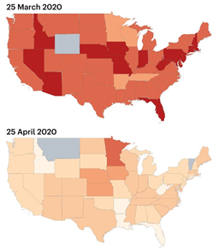
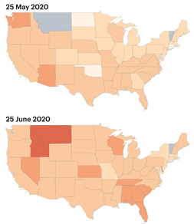
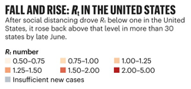
R – Reproduction Number

Slide 8
Pandemic Spread Variables
Zika virus spread from Brazil in 2015 and spread through out the Americas.
Dynamic Neural Network model was developed and had three main dimensions
Selection of the chosen risk indicator
Risk classification scheme
Prediction forecast window
Popular parameters – Infection rate and Infectiousness time
Pandemic spread specific variables can include
Connectivity-risk variables
Case-weighted travel risk
Incidence-weighted travel risk

Slide 9
Pandemic Spread Models
Standard SIR Model – Simplest and most popular method.
S – Number of susceptible individuals
I – Number of infectious individuals
R – Number of removed or deceased individuals
Delay Model - Simple realistic model for diffusion of an infectious disease. Governed by a single functional delay differential equation. Can even work when a time-dependent infection rate variable is present.
SEIR Model – Seasonality and period-doubling bifurcations in an epidemic model.
S + E + I + R = 1
S – Fraction of susceptible individuals
E – Fraction of exposed individuals (Infected but not infectious)
I – Fraction of Infective individuals
R – Fraction of recovered individuals

Slide 10
COVID 19 Spread Prediction Models
American Health Association (AHA) has collated various prediction models and they are being used by hospitals and health systems in making their own decisions to arrest the pandemic spread.
Case Projection and Capacity Planning – Predication on assumptions about current status of the disease, how quickly it spreads and/or degree of containment effort.
Community Vulnerability Maps – Uses density, distance to health care, economic status etc. to highlight areas that are at risk for contracting or dying to the disease.
Case Mapping and Projection Tools – Visual description of disease at national, state or county levels.
SQUIDER Model – Variation of SIR model
S(Susceptible) + Q(Pseudo-Quarantine/Social Distancing)+ U(Undetected Infected) + I(Detected Infected)+ D(Detected Deaths) + E(Undetected Recovered/Death) + R(Detected Recovered) = 1

Slide 11
COVID Calculator
MicroCOVID project was a project developed that would calculate the user’s probability of contracting COVID in his/her county depending on the scenario that the user provides as input
Started out as a project amongst friends so that decisions to attend any event is approached scientifically instead of being an emotional decision in these turbulent times.
The underlying model considers the latest research on masks, vaccine efficacy, current COVID counts in each county etc. and converts them into a numeric value.
The risk is measured in a unit called microCOVIDs – One in a million chance of becoming infected with COVID
Any given user is budgeted 10000 microCOVIDs per year that translates to a 1 percent chance of contracting COVID.
To use the calculator, you need to provide details of the event like Going Grocery Shopping/Attending an Outdoor event in a different county etc. with other details and the tool will calculate the user’s risk in terms of microCOVIDs.

Slide 12
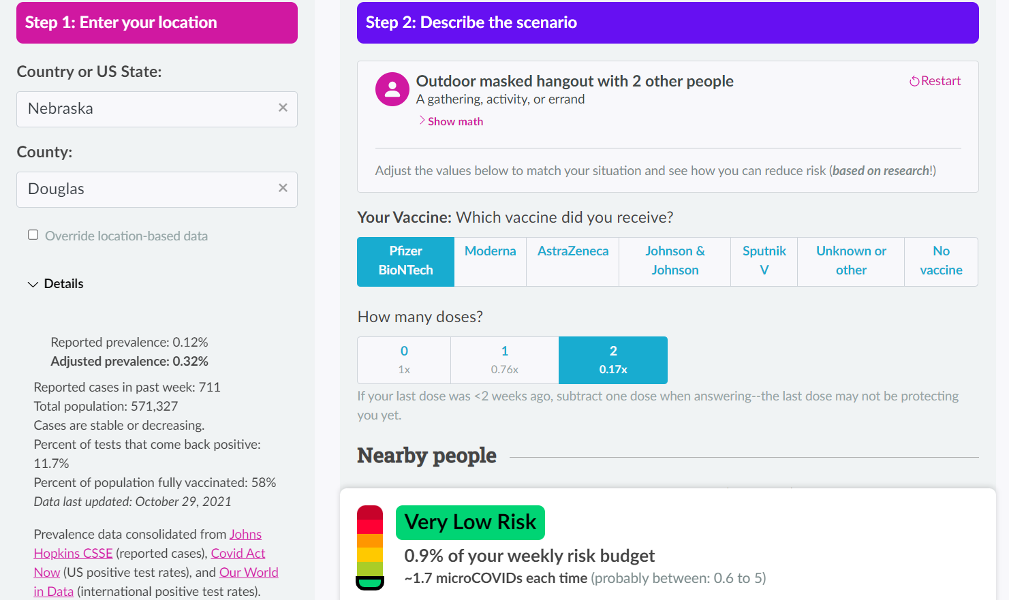
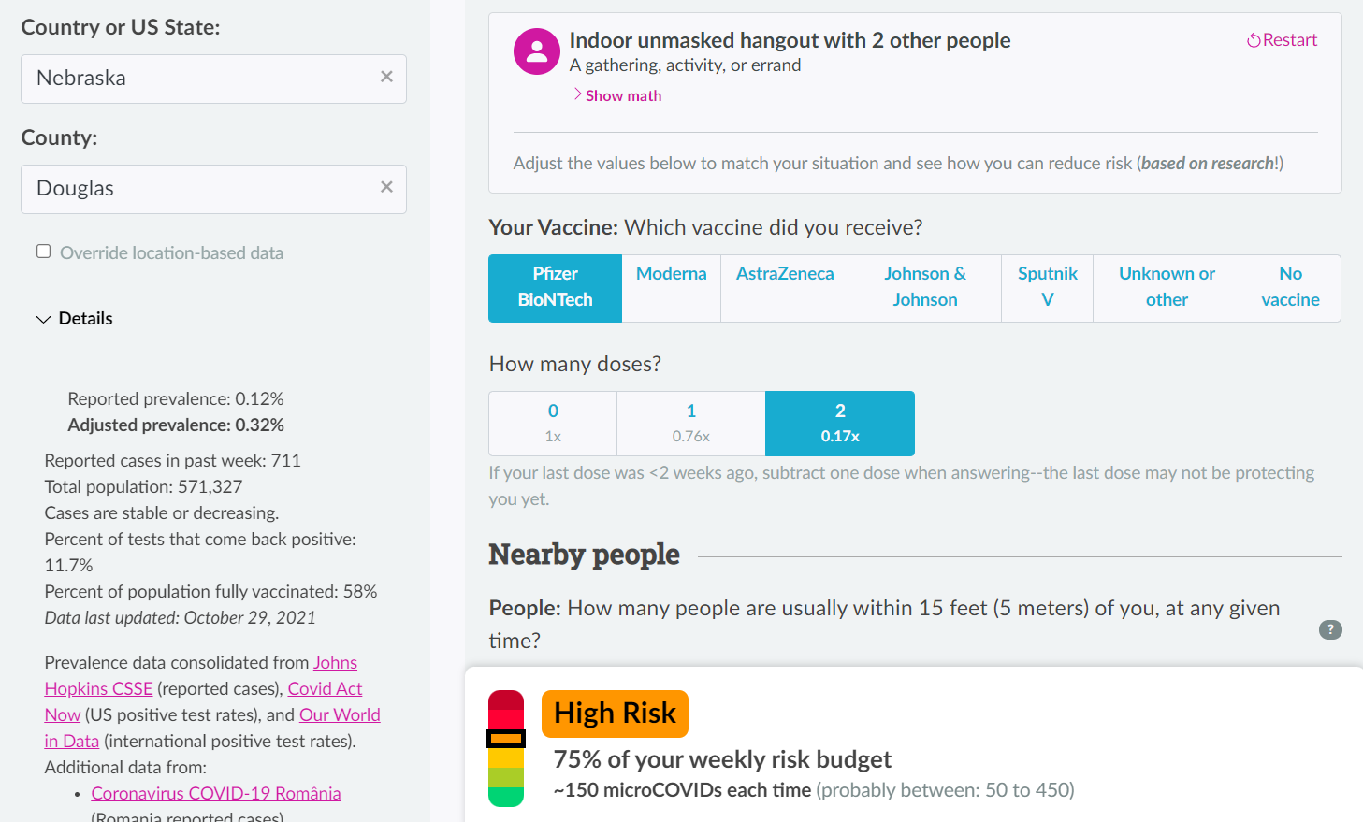
COVID Calculator

Slide 13
Conclusion
As we can see even before COVID 19, we were able to predict the spread of an outbreak like Zika/SARS etc. albeit that had a lower spread.
The spread of COVID 19 and the international response to it was overwhelming both by governments and scientists alike.
There were a lot of models and predictor tools that were created by universities and scientists and crowd-sourced tools that were accurate given the number of variables.
Tech-savvy governments like Singapore, Korea etc. were quick to use these predictor tools to calculate the pandemic spread and issue corresponding directives to control the spread.
But we must keep in mind that not all the factors can be considered, but we can certainly say that we can make an accurate pandemic spread prediction tool.

Slide 14
References
https://apic.org/monthly_alerts/outbreaks-epidemics-and-pandemics-what-you-need-to-know/
https://www.bbc.com/future/article/20200812-exponential-growth-bias-the-numerical-error-behind-covid-19
https://www.washingtonpost.com/graphics/2020/world/corona-simulator/
https://www.nature.com/articles/d41586-020-02009-w
https://bmcmedicine.biomedcentral.com/articles/10.1186/s12916-019-1389-3
https://www.ncbi.nlm.nih.gov/pmc/articles/PMC7190554/
https://www.aha.org/guidesreports/2020-04-09-compendium-models-predict-spread-covid-19
https://www.smithsonianmag.com/innovation/this-calculator-estimates-your-risk-of-getting-covid-19-180978670/

